Slide 1




HiLabs
.
PRODUCT MANAGEMENT CASE STUDY
4-6 Weeks
Enhanced Contract
Target negotiation cycle time (reduced from 3-6 months)
Management System
>95%
Provider data accuracy with MCheck integration
CLEAN DATA. HIDDEN POTENTIAL. UNLOCKED.
Turning dirty data into contract intelligence for faster, safer payer-provider agreements using advanced AI & NLP
<1%
Contract leakage risk with automated detection
Gartner 2025
KLAS 2025
$39M Series B
Hype Cycle Recognition
Points of Light Awardee
Recent Funding
Aditi Mittal
PGID: 62510304
PGP | ISB

Slide 2





MARKET CONTEXT
The Cost of Fragmentation & "Dirty Data"
HiLabs.
Critical Pain Points
Manual Contracting Overhead
The "Dirty Data" Crisis
Teams rely on static spreadsheets and fragmented
emails. $20-23B annual admin cost with negotiation
cycles dragging on for 3-6 months.
81% of provider directory data is incorrect. This
creates downstream claim errors, audit failures
(>95% for MA plans), and provider abrasion.
Information Asymmetry
Regulatory Imperatives
Providers often have better market data than payers.
Contracting managers lack real-time benchmarking
visibility during negotiations.
Transparency in Coverage (TiC)
No Surprises Act (NSA)
Mandates public pricing disclosure, demanding accurate, machine-readable data.
Requires accurate directories
and advanced cost estimates
to protect members.
Source: McKinsey Administrative Simplification Report; CMS Audit Reports 2024
02

Slide 3











CURRENT STATE ANALYSIS
User Personas & Workflow Friction
HiLabs.
Key Stakeholders & Pain Points
The Broken Contracting Lifecycle
Network Contract Manager
Provider Relations Rep
Manual Info
Offline Neg.
Static Model
Lack of real-time benchmarks vs. providers
Overwhelmed by volume (email/PDFs)
Drafting &
Negotiation
Impact
Legal
High abrasion from directory errors
Proposal
(Email/Phone)
Modeling
Review
Weeks spent manually gathering data
Reality: 3–6-month cycle time with multiple "swivel-chair" handoffs between Word, Excel, and Email.
Legal & Compliance
Financial Analyst
$1,000+
High
6 Mo
Risk of missing deviations in long docs
Static Excel models with stale data
Manual audits for TiC/NSA compliance
Cannot simulate 'shadow claims' fast enough
Leakage Risk (Stop-Loss)
Admin Cost Per Contract
Avg. Cycle Time
Analysis based on internal workflow audit and industry benchmarks (HiLabs Research)
03

Slide 4
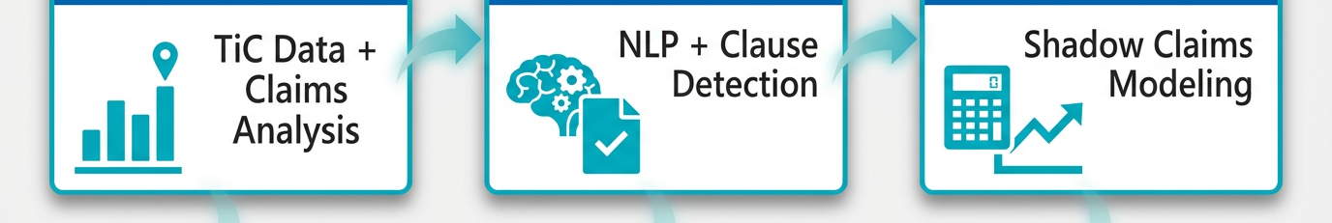











SOLUTION ARCHITECTURE
AI-Native Contract Intelligence Platform
HiLabs.
PLATFORM SERVICES
Centralized Repository
Natural Language Search
Audit Trail & Compliance
MCheck™ Data Integration
Powered by HiLabs AI Core
Rate Benchmarking
Negotiation Assist
Contract Simulation
Market Intelligence Layer
Co-Pilot Workflow
Financial Modeling
TiC Data Ingestion: Process machine-readable files to benchmark vs. market rates.
Clause Extraction (NLP): Auto-detect deviations from standard playbooks.
Shadow Claims Pricing: Reprice historical claims with proposed terms.
R3 Scoring Algorithm: Evaluate benchmarks for reliability, recency, and relevance.
Financial Trap Detector: Flag missing "lesser-of" clauses and stop-loss risks.
Scenario Modeling: Real-time "what-if" analysis for MLR impact.
Geo-Specific Norms: CBSA and Medicare reimbursement comparisons.
RAG-Grounded Scripts: Generate negotiation talking points with audit trails.
Premium Impact: Project cost-per-member-per-month (PMPM) changes.
Modules are designed for seamless integration with existing CLM and Claims Systems (Facets, QNXT)
04

Slide 5






COMPETITIVE ADVANTAGE
Why HiLabs Wins: Tech Differentiation
HiLabs.
Healthcare-Specific NLP
Capability
Generic CLM
HiLabs AI
Trained on millions of provider contracts, manuals, and Medicaid agreements—not generic legal texts.
Clause Extraction
Keywords only
Semantic & Contextual
Semantic Understanding
Identify legal terms in contracts
Benchmarking
None / Manual Upload
Real-time TiC Data
RAG Architecture
Compare rates vs market
Retrieval-Augmented Generation ensures all AI outputs are grounded in source docs. Zero hallucinations.
Deviation Detection
Rule-based
AI Playbook Match
Audit-Ready
Flag non-standard terms
R3 Scoring Algorithm
Financial Simulation
Offline Excel
Integrated Shadow Pricing
Proprietary scoring for benchmarks based on Reliability, Recency, and Relevance weights.
Model impact on MLR
Data Quality
The "Defensible" Outcome
100%
10x
Higher precision, faster throughput, and total auditability.
TRACEABLE
FASTER REVIEW
MCheck™ Integration
Deep integration with existing provider data foundation ensures accuracy across the lifecycle.
Unified Data
Differentiation based on proprietary technology stack and deep healthcare domain expertise.
05

Slide 6











GO-TO-MARKET STRATEGY
Implementation Roadmap & Rollout
HiLabs.
MONTHS 1-3
MONTHS 4-6
MONTHS 7-12
Data Foundation
Pilot "Co-Pilot"
Financial Integration
Ingest & digitize historical provider contracts
Deploy workflow to core negotiation team
Connect claims warehouse for "shadow pricing”
Train NLP extractors on client templates
Validate deviation detection accuracy
Enable enterprise-wide deployment
Stand up MCheck™ API connections
Iterative feedback loop for UX refinement
Measure MLR impact & NSA compliance
KEY DELIVERABLE
SUCCESS METRIC
TARGET OUTCOME
Searchable Repo & Baseline Accuracy
>70% User Adoption in Pilot Group
Audit-Ready Compliance & ROI
Target Buyers (ICP)
VP Network Management
CDO / CIO
Head of Payment Integrity
General Counsel
Phased approach minimizes operational disruption while accelerating time-to-value.
06

Slide 7



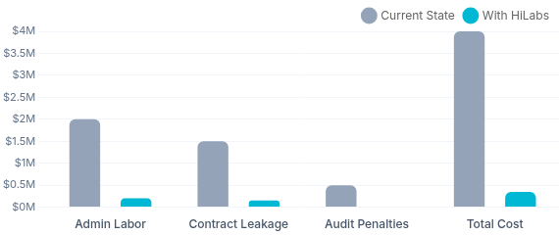


BUSINESS IMPACT & ROI
Quantifiable Value & Transformation
HiLabs.
NEGOTIATION CYCLE TIME
Projected Annual Savings
$1.8M Savings
3-6 Months
4-6 Weeks
Based on 2,000 contracts per year volume
Manual Process
AI-Assisted Workflow
ADMIN COST PER CONTRACT
$500-$1,000+
<$100
Traditional CLM
HiLabs Automated
PROVIDER DATA ACCURACY
70-80%
>95%
Current Baseline
MCheck™ Verified
CONTRACT LEAKAGE
PROVIDER SATISFACTION
<1%
+40%
NSA Compliance Risk
Reduction in missed stop-loss clauses and financial traps
Estimated improvement due to faster payments and accurate data
Shift from manual, high-risk audits to 100% automated, audit-ready reporting.
07

Slide 8













STRATEGIC VISION
Product Roadmap: The Path to Autonomy
HiLabs.
NOW - 6 MONTHS
6 - 12 MONTHS
12 - 24 MONTHS
Foundation & Assist
Simulation & Scale
Agentic AI & VBC
Fixing the data & enabling users
Deep financial integration
Autonomous contract operations
Centralized Repository: Digitized contracts with metadata search.
Simulation Engine: Shadow claims pricing & MLR impact modeling.
Agentic AI: Autonomous negotiation for low-risk standard contracts.
Rate Benchmarking V1: TiC data integration for key markets.
Automated Redlining: AI suggestions for clause remediation.
VBC Modeling: Complex incentive & quality bonus simulations.
Clause Extraction: Detect non-standard terms (payment, term).
Delegated Entity Monitor: Compliance tracking for downstream partners.
Predictive Win-Rates: AI likelihood scores for proposed terms.
Renewal Alerts: Proactive notifications for expiring contracts.
Pricing Export: Push approved rates to adjudication systems.
Bi-Directional Sync: Real-time updates between CLM and Core Admin.
Word Add-In: Read-only contract insights within MS Word.
Ready to Transform Contract Management?
Launch Pilot Program
Partner with HiLabs to deploy an AI-native, audit-ready intelligence layer.
Roadmap subject to quarterly review based on customer feedback and market dynamics.
08

